Slide 1
Networks with Adversarial Examples
Attacking NNs with Adversarial Examples
Generative Adversarial Networks

Slide 2
I. Adversarial examples
Attacking a network with adversarial examples
Defenses against adversarial examples
Why are neural networks vulnerable to adversarial examples?
[Szegedy et al. (2013): Intriguing properties of neural networks]
[Ian J. Goodfellow, Jonathon Shlens & Christian Szegedy (2015): Explaining and harnessing adversarial examples]

Slide 3

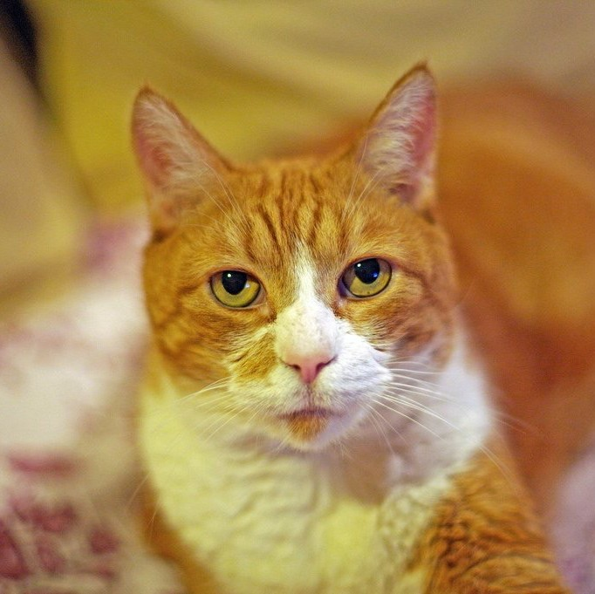
Goal: Given a network pretrained on ImageNet, find an input image that is
not an iguana but will be classified as an iguana.
Neural network (pretrained on ImageNet)
⎛ 0.04⎞
“car”
x
⎜:0.85⎟
“iguana
⎜ ⎟
⎜:0.02 ⎟
⎜ 0.07⎟
“tomato”
⎜ ⎟
“bike”
⎜ 0.801⎟
““ccaatt””
⎜ ⎟
⎜:
⎟
⎜⎝⎜⎝ 0.072⎟⎠⎟⎠
“crab”
⎛ 0⎞
1. Rephrasing what we want:
⎜₁⎟
2. Defining the loss function
3. Optimize the image
⎜ ⎟
⎜: ⎟
⎜ ⎟
1
2
x
Find x such that: yˆ(x) = y
= ⎜ 0⎟
⎜ 0⎟
⎜: ⎟
L( yˆ, y) =
yˆ(W ,b, x) − y
2
Network (pretrained on ImageNet)
L( yˆ, y)
iguana
iguana
2
⎜ ⎟
After many iterations
⎜_{⎝ 0}⎟⎠
?
∂L
∂x
x = x − α ^{∂L}
∂x
[Ian J. Goodfellow, Jonathon Shlens & Christian Szegedy (2015): Explaining and harnessing adversarial examples]

Slide 4
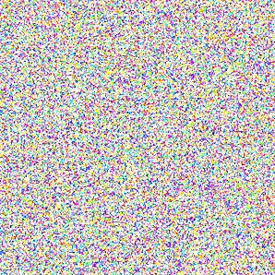
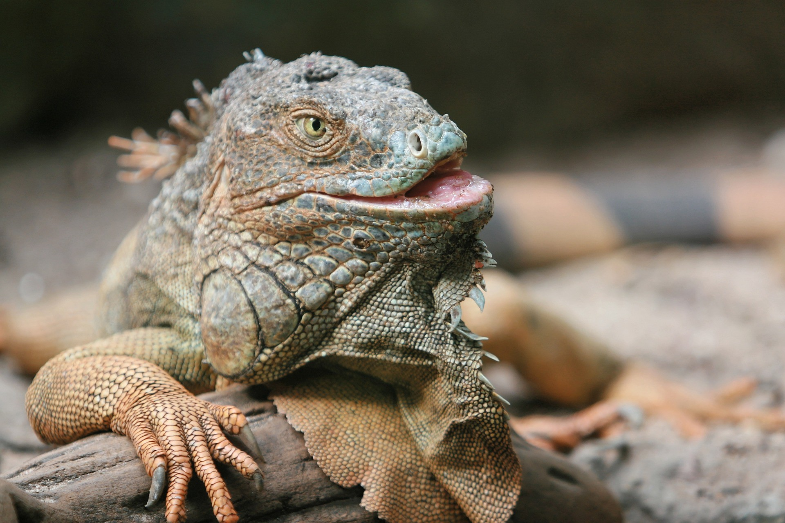
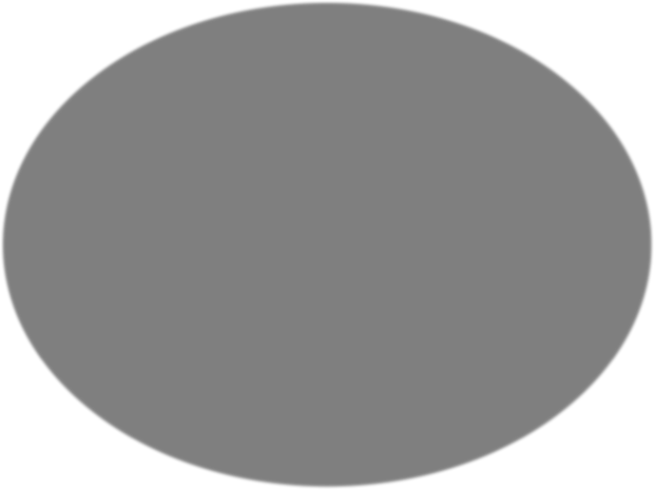
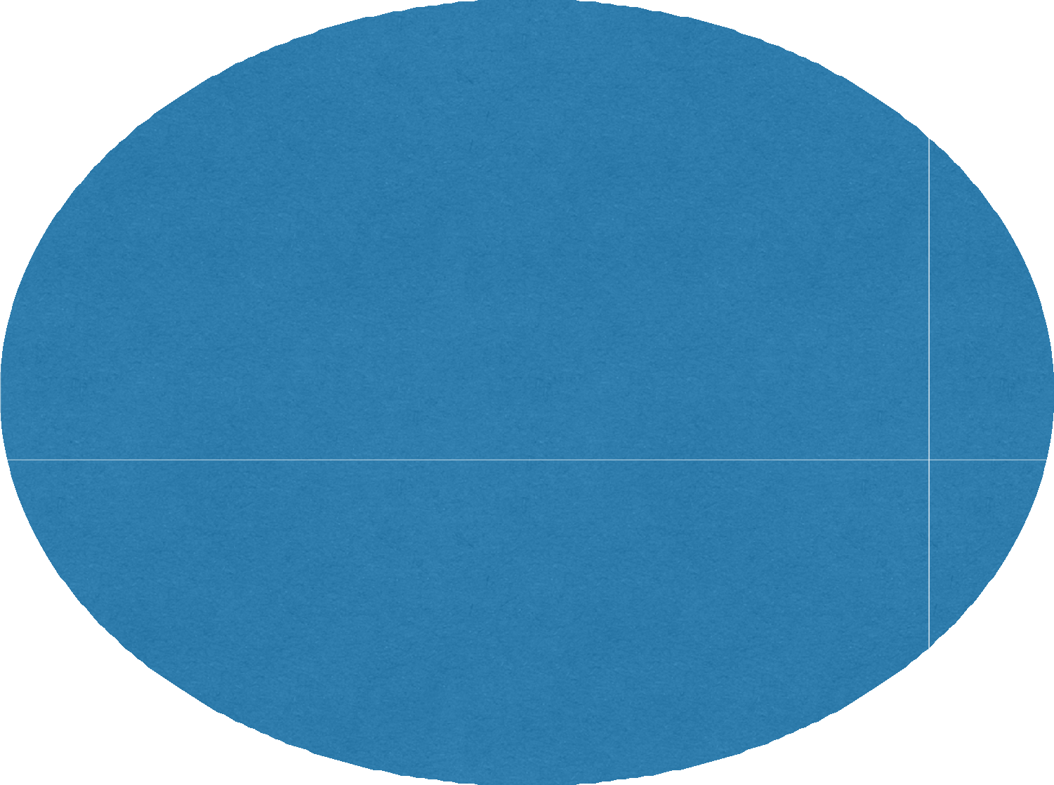


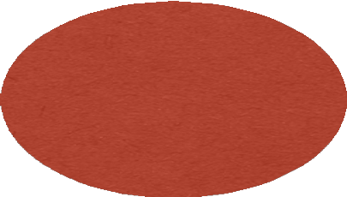
I. A. Attacking a network with adversarial examples
Question: Will the forged image x look like an iguana?
?
₂₅₆32×32×3 _{≈ 10}7400
Space of possible input images
Space of images classified as iguanas
Space of real images

Slide 5



Goal: Given a network pretrained on ImageNet, find an input image that
is a cat but will be classify as an iguana.
Neural network (pretrained on ImageNet)
⎛ 0.04⎞
“car”
⎜:0.85⎟
“iguana
⎜ ⎟
⎜:0.02 ⎟
⎜ 0.07⎟
“tomato”
⎜ ⎟
“bike”
⎜ 0.801⎟
““ccaatt””
⎜ ⎟
⎜:
⎟
⎜⎝⎜⎝ 0.072⎟⎠⎟⎠
“crab”
1. Rephrasing what we want:
⎛ 0⎞
2. Defining the loss function
3. Optimize the image
⎜₁⎟
⎜ ⎟
⎜: ⎟
Find x such that:
₌ ⎜ ₀⎟
1
2
2
x
Network (pretrained on ImageNet)
L( yˆ, y)
yˆ(x) = y
iguana
⎜ ⎟
⎜ 0⎟
L( yˆ, y) =
yˆ(W ,b, x) − y_{iguana}
2
⎜: ⎟
2
2
⎜ ⎟
+λ x − x_{cat}
⎜_{⎝ 0}⎟⎠
After many iterations
And:
x = x
cat
∂L
∂x
?
x = x − α ^{∂L}
∂x
[Ian J. Goodfellow, Jonathon Shlens & Christian Szegedy (2015): Explaining and harnessing adversarial examples]

Slide 6


I. A. Attacking a network with adversarial examples
92% Cat
94% Iguana

Slide 7
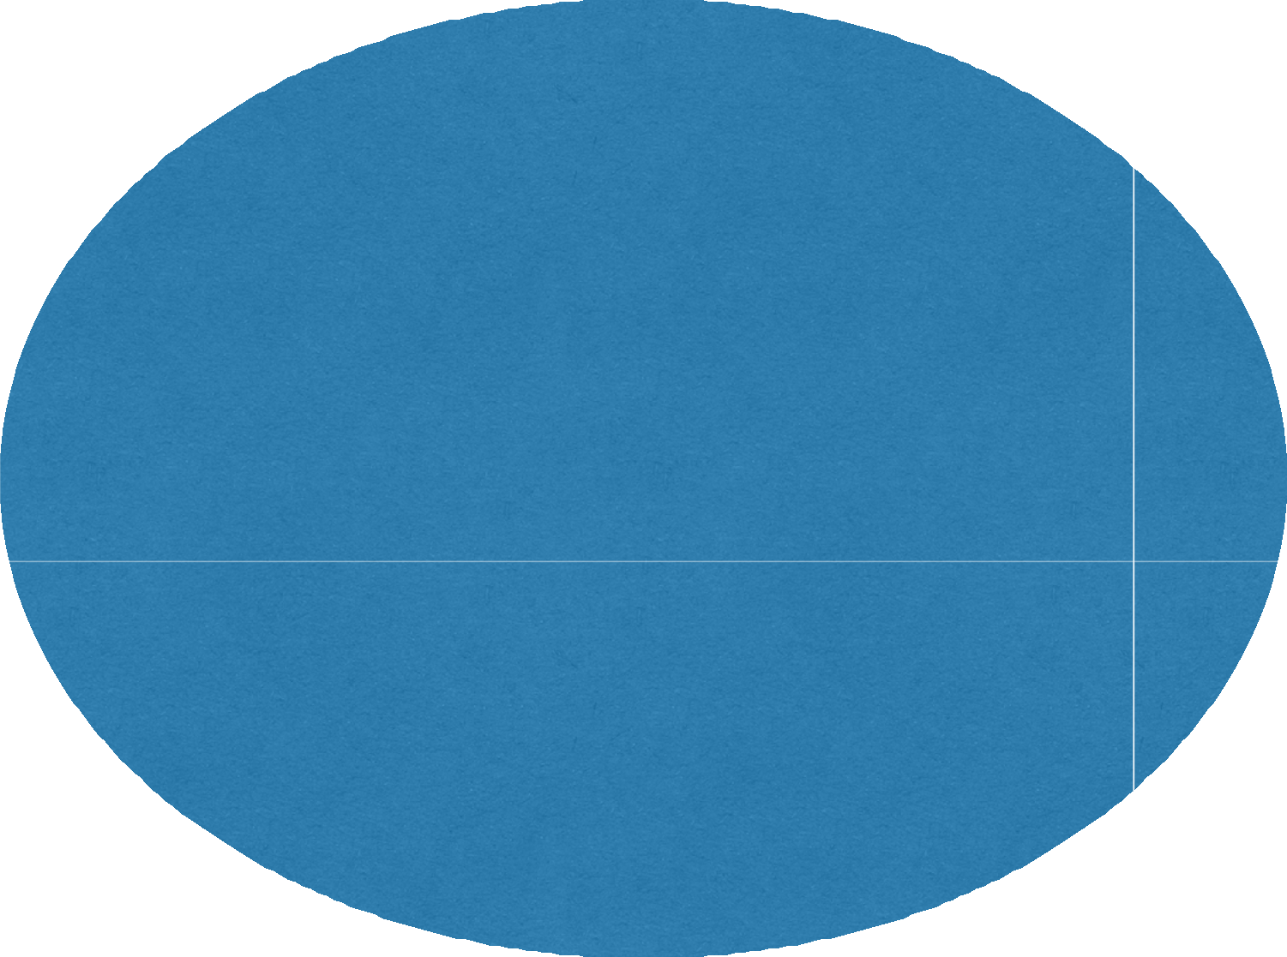


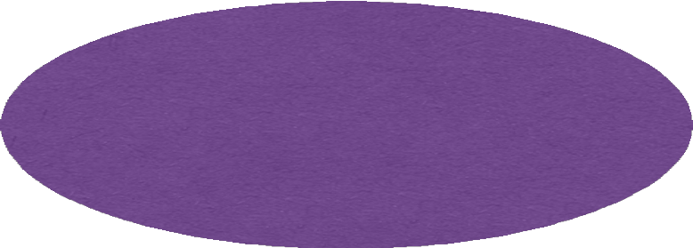
I. A. Attacking a network with adversarial examples
₂₅₆32×32×3 _{≈ 10}7400
Space of possible input images
Space of images classified as iguanas
Space of real images
Space of images that look real to humans

Slide 8

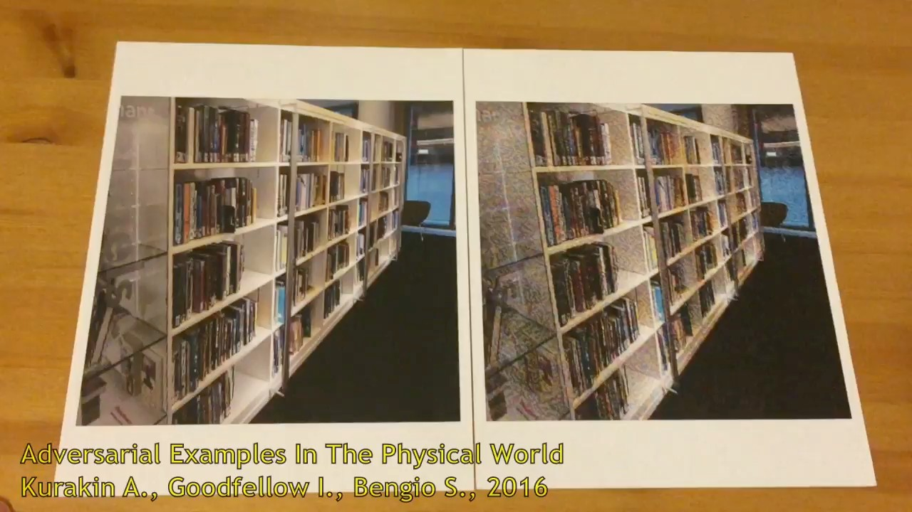

Menti
[Alexey Kurakin, Ian J. Goodfellow, Samy Bengio (2017): Adversarial examples in the physical world]

Slide 9



I. B. Defenses against adversarial examples
Menti
Knowledge of the attacker:
•
•
White-box Black-box
Solution 1
•
Create a SafetyNet
Solution 2
x =
y = cat
•
Train on correctly labelled adversarial examples
Solution 3
•
Adversarial training
L_{new} = L(W ,b, x, y) + λ L(W ,b, x_{adv} , y)
Adversarial logit pairing
L_{new} = L(W ,b, x, y) + λ
f (x;W ,b) − f (x_{adv} ;W ,b)
2
2
[Lu et al. (2017): SafetyNet: Detecting and Rejecting Adversarial Examples Robustly] [Harini Kannan et al. (2018): Adversarial Logit Pairing]

Slide 10
II. Generative Adversarial Networks (GANs)
Motivation
G/D Game
Training GANs
In terms of code
Nice results
[Ian J. Goodfellow, Jonathon Shlens & Christian Szegedy (2015): Explaining and harnessing adversarial examples]

Slide 11
II.A - Motivation
Motivation: endowing computers with an understanding of our world.
Goal: collect a lot of data, use it to train a model to generate similar data from scratch.
Intuition: number of parameters of the model << amount of data

Slide 12
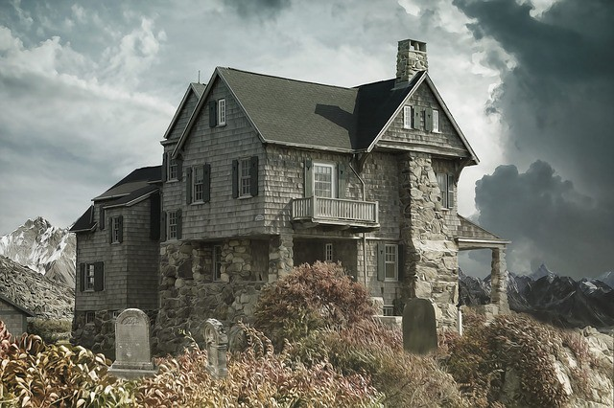
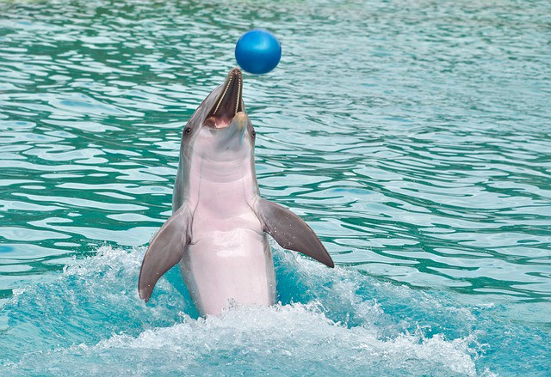
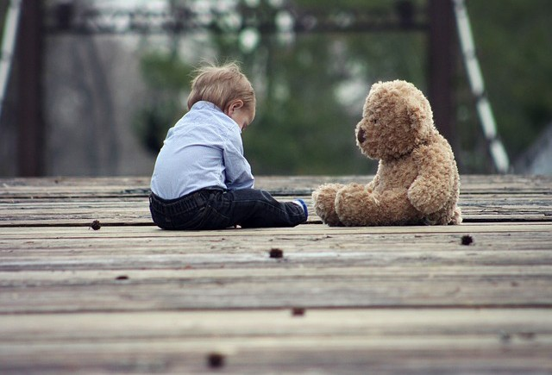
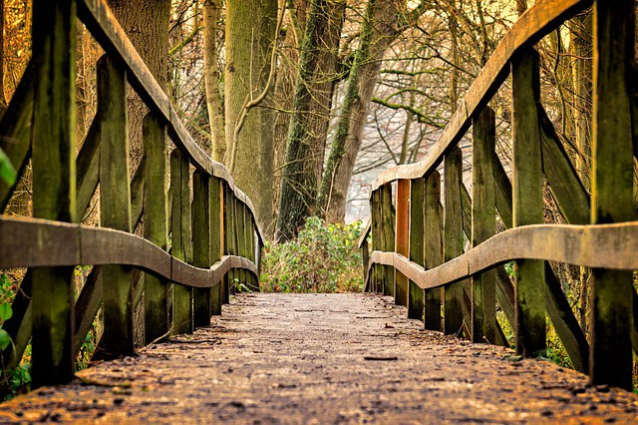


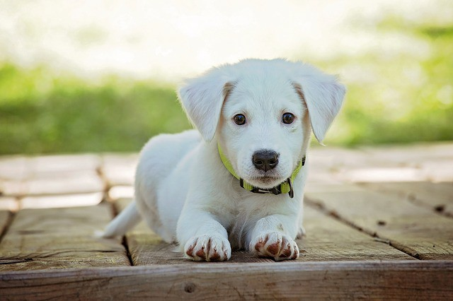
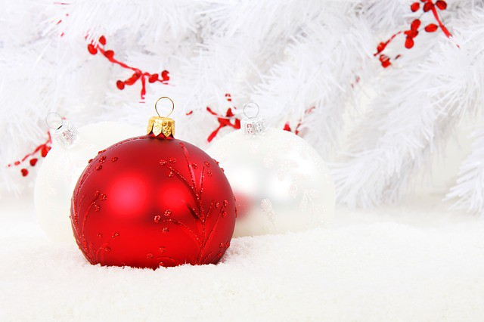
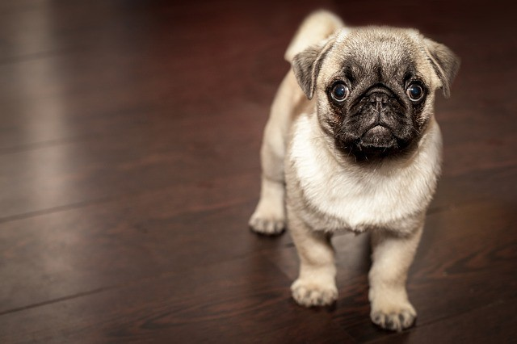
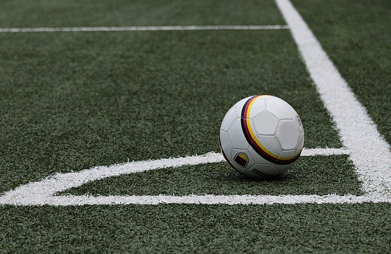


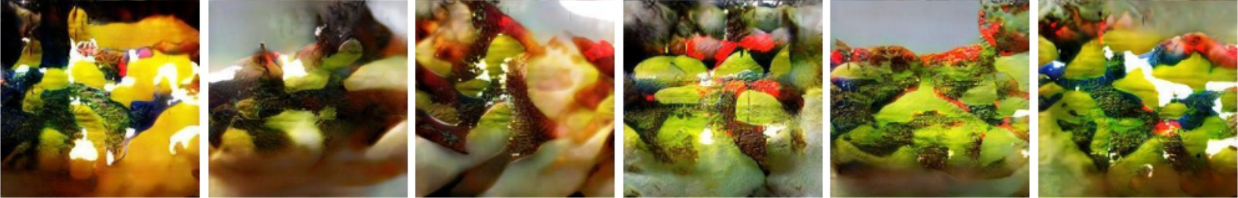
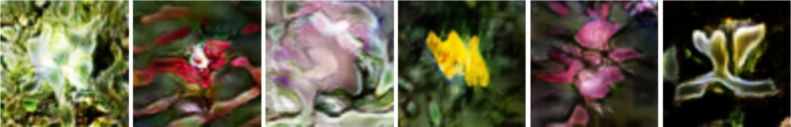
II.A - Motivation
Probability distributions:
Samples from the “real data distribution”
“real data distribution”
Image space
Matching distributions
Image space
Goal
Samples from the “generated distribution”
“generated distribution”
Image space
[Han Zhang, Tao Xu, Hongsheng Li, Shaoting Zhang, Xiaogang Wang, Xiaolei Huang, Dimitris Metaxas (2017): StackGAN: Text to Photo-realistic Image Synthesis with Stacked Generative Adversarial Networks]

Slide 13
II. Generative Adversarial Networks (GANs)
Motivation
G/D Game
Training GANs
In terms of code
Nice results
[Ian J. Goodfellow, Jonathon Shlens & Christian Szegedy (2015): Explaining and harnessing adversarial examples]

Slide 14
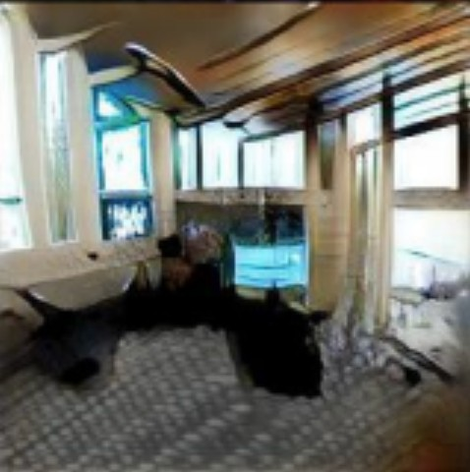
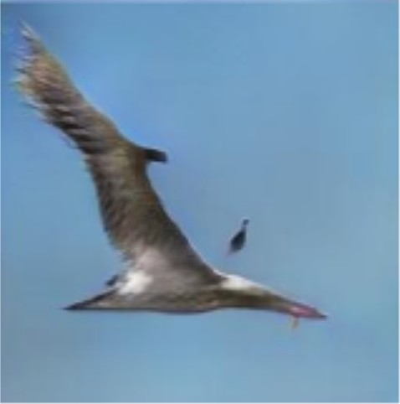
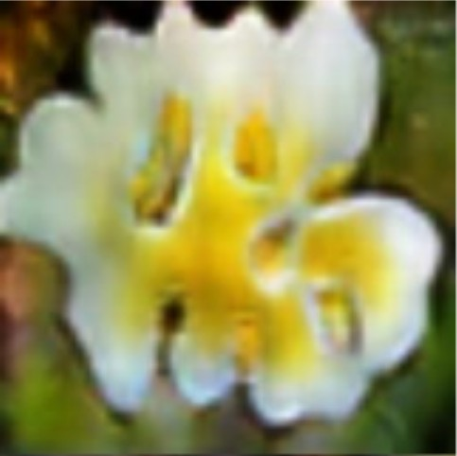
II.B - G/D Game
100-d
random code
(64,64,3)
generated image
⎛ 0.47⎞
Generator “G” (Neural Network)
≠
⎜ ⎟
⎜ ⎟
⎜ ⎟
⎜⎝ 0.19⎟⎠
z
How can we train G to generate images from the true data distributions?
[Han Zhang, Tao Xu, Hongsheng Li, Shaoting Zhang, Xiaogang Wang, Xiaolei Huang, Dimitris Metaxas (2017): StackGAN: Text to Photo-realistic Image Synthesis with Stacked Generative Adversarial Networks]

Slide 15
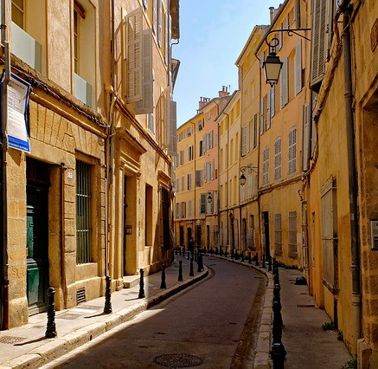
II.B - G/D Game
100-d
random code
(64,64,3)
generated image
⎛ 0.47⎞
Generator “G” (Neural Network)
Run Adam simultaneously on two minibatches (true data / generated data)
⎜ ⎟
⎜ ⎟
⎜ ⎟
⎜⎝ 0.19⎟⎠
z
Gradients
Binary classification
Discriminator “D” (Neural Network)
⎧⎪ y = 0 if x = G(z)
x
⎨
⎪⎩ y = 1 otherwise
Probability distributions
Real images (database)
Image space

Slide 16
II.B - G/D Game
100-d
random code
(64,64,3)
generated image
⎛ 0.47⎞
Generator “G” (Neural Network)
⎜ ⎟
⎜ ⎟
⎜ ⎟
⎜⎝ 0.19⎟⎠
z
_{Gradients}Binary classification
Discriminator “D” (Neural Network)
End goal: G is outputting images that are indistinguishable from real images for D
⎪⎧ y = 0 if x = G(z)
x
⎨
⎪⎩ y = 1 otherwise
Probability distribution
Real images (database)
Image space

Slide 17
II.B - G/D Game
is always 1
⎪⎩ is always 0
⎧⎪ ^{y}real
Training procedure, we want to minimize:
The cost of the discriminator
Labels: ⎨ _{y}
gen
_{J} ( D ) ₌ ₋
1
^{m}real
1
^{m}gen
∑
y
( i ) ( i )
∑
i=₋1
( i )
gen
( i )
.log( D(x )) −
(1− y
).log(1− D(G(z )))
m
real
m
rea₋l
^{i}-⁼¹ -� �
ge₋n
� �
cross-entropy 1:
“D should correctly label real data as 1”
cross-entropy 2:
“D should correctly label generated data as 0”
•
The cost of the generator
_{J} (G ) _{= − J} ( D ) ₌
1
^{m}gen
∑
log(1− D(G(z^{( i )} )))
“G should try to fool D: by minimizing the opposite of what D is trying to minimize”
m
gen
i=1

Slide 18
II. Generative Adversarial Networks (GANs)
Motivation
G/D Game
Training GANs
In terms of code
Nice results
[Ian J. Goodfellow, Jonathon Shlens & Christian Szegedy (2015): Explaining and harnessing adversarial examples]

Slide 19
II.C - Training GANs
Saturating cost for the generator:
⎡
1
^{m}gen
⎤ ⎡
1
^{m}gen
⎤ ⎡
1
^{m}gen
⎤
min ⎢
∑log(1− D(G(z^{( i )} )))⎥ ⇔ max ⎢
∑log( D(G(z^{( i )} )))⎥ ⇔ min ⎢−
∑log( D(G(z^{( i )} )))⎥
⎣⎢ ^{m}gen
i=1
⎥⎦
⎢⎣ ^{m}gen
i=1
⎦⎥
⎢⎣
^{m}gen
i=1
⎥⎦
5
Non-saturating cost_{m}
_{J} (G ) ₌ ₋ ¹ ∑
gen
log( D(G(z^{( i )} )))
0
_{J} (G )
^{m}gen
i=1
Saturating cost
^{m}gen
J ^{(G )} = ¹ ∑log(1− D(G(z^{( i )} )))
-20
^{m}gen
i=1
0
D(G(z))
1
[Ian Goodfellow (2014): NIPS Tutorial: GANs]

Slide 20
II.C - Training GANs
⎡
1
^{m}gen
⎤ ⎡
1
^{m}gen
⎤ ⎡
1
^{m}gen
⎤
Note that:
min ⎢
∑log(1− D(G(z^{( i )} )))⎥ ⇔ max ⎢
∑log( D(G(z^{( i )} )))⎥ ⇔ min ⎢−
∑log( D(G(z^{( i )} )))⎥
⎢⎣ ^{m}gen
i=1
⎥⎦
⎢⎣ ^{m}gen
i=1
⎥⎦
⎢⎣
^{m}gen
i=1
⎥⎦
New training procedure, we want to minimize:
_{J} ( D ) ₌ ₋
1
^{m}real
1
^{m}gen
∑
y
( i ) ( i )
∑
i=₋1
( i )
gen
( i )
.log( D(x )) −
(1− y
).log(1− D(G(z )))
m
real
m
rea₋l
^{i}-⁼¹ -� �
ge₋n
� �
cross-entropy 1:
“D should correctly label real data as 1”
cross-entropy 2:
“D should correctly label generated data as 0”
1
^{m}gen
_{J} (G ) ₌ ₋
∑log( D(G(z^{( i )} )))
“G should try to fool D: by minimizing this”
^{m}gen
i=1

Slide 21
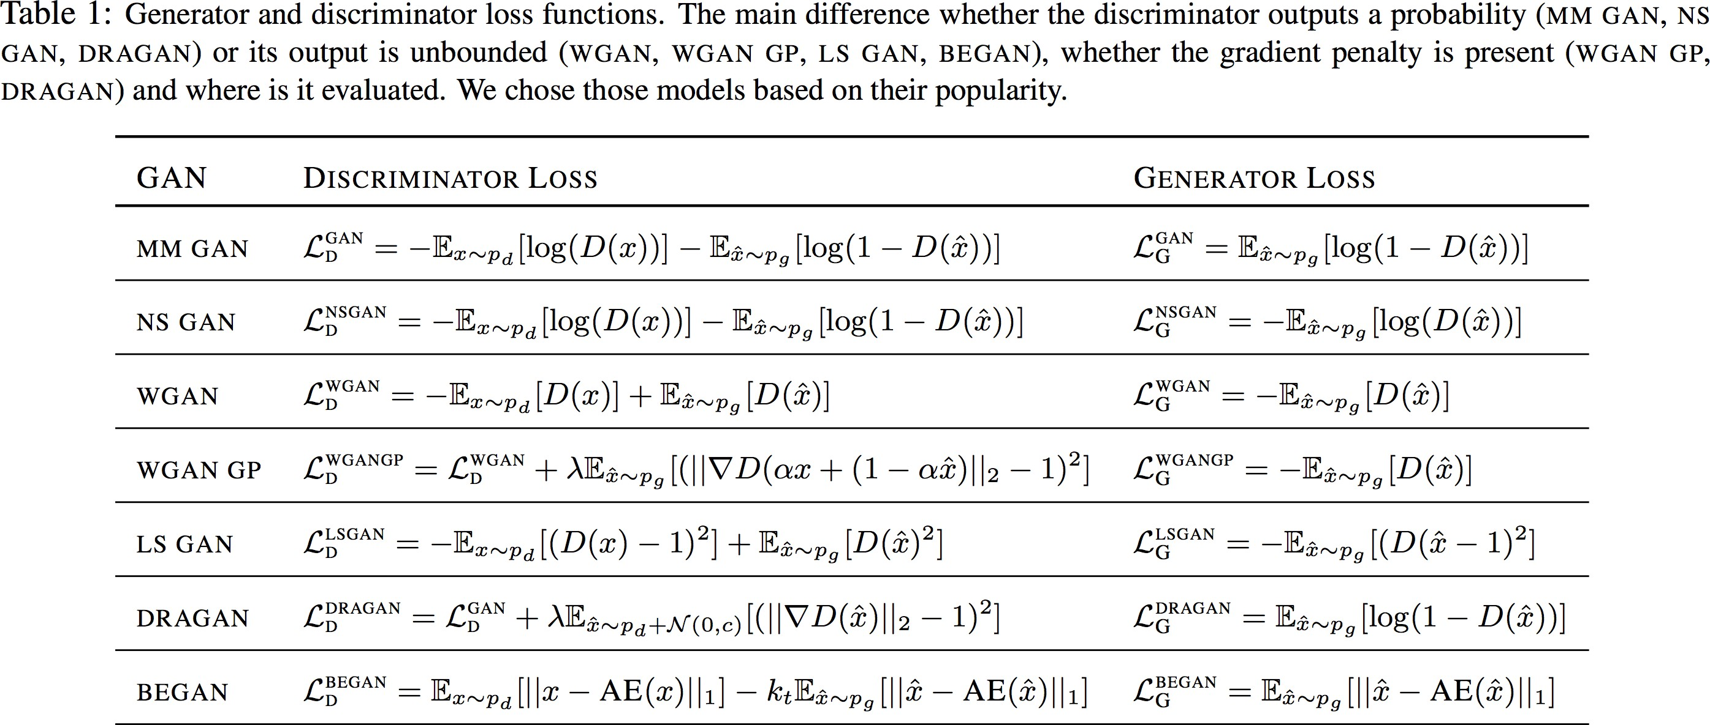
[Lucic, Kurach et al. (2018): Are GANs Created Equal? A Large-Scale Study]

Slide 22


II.C - Training GANs
Simultaneously training G/D?
5
Non-saturating cost
0
1
m_{g}
_{J} (G ) ₌ ₋
∑log( D(G(z^{( i )} )))
_{J} (G )
m_{g}
for num_iterations:
for k iterations: update D
update G
i=1
Saturating cost
1
m_{g}
_{J} (G ) ₌
∑log(1− D(G(z^{( i )} )))
m_{g}
i=1
-20
0
D(G(z))
1
[Ian Goodfellow (2014): NIPS Tutorial: GANs]

Slide 23
II.C - Training GANs
5
Non-saturating cost
_{J} (G ) ₌ ₋ ¹ ∑
g
log( D(G(z^{( i )} )))
0
m
Recap: GANs’ training tips
_{J} (G )
m_{g}
Saturating cost
i=1
1
m_{g}
_{J} (G ) ₌
∑log(1− D(G(z^{( i )} )))
m_{g}
i=1
•
Modification of the cost function
0
D(G(z))
1
•
Keep D up-to-date with respect to G (k update for D / 1 update for G)
•
(not presented but important) Use Virtual Batchnorm
And a lot more, GANs are hard to train!
[Soumith et al. (2016): GanHacks]
[Lucic, Kurach et al. (2018): Are GANs Created Equal? A Large-Scale Study]

Slide 24
II. Generative Adversarial Networks (GANs)
Motivation
G/D Game
Training GANs
In terms of code
Nice results
[Ian J. Goodfellow, Jonathon Shlens & Christian Szegedy (2015): Explaining and harnessing adversarial examples]

Slide 25
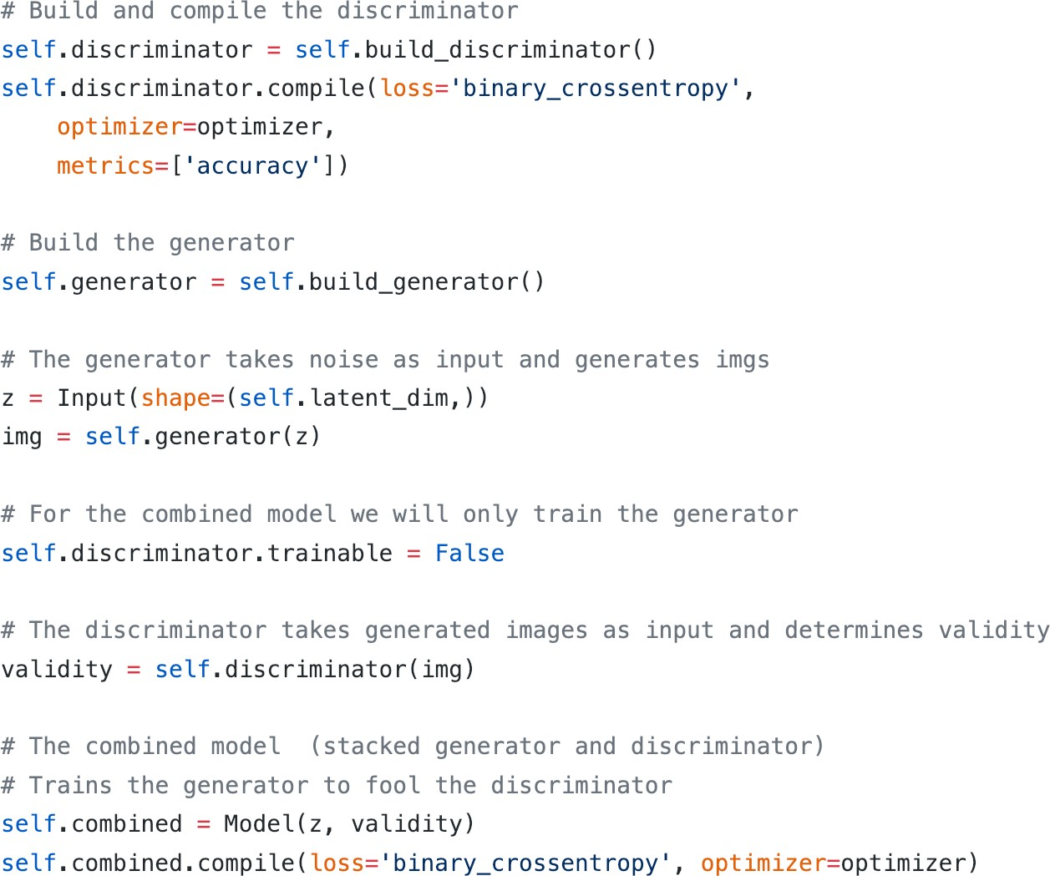
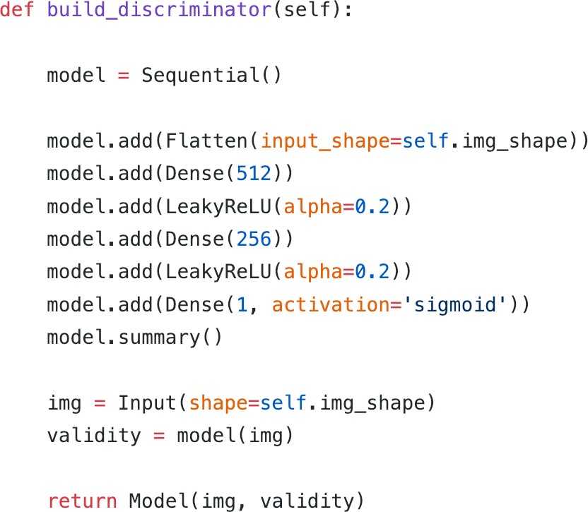
II. D. In terms of code
[Erik Linder-Norén (Github): eriklindernoren/Keras-GAN: link]

Slide 26
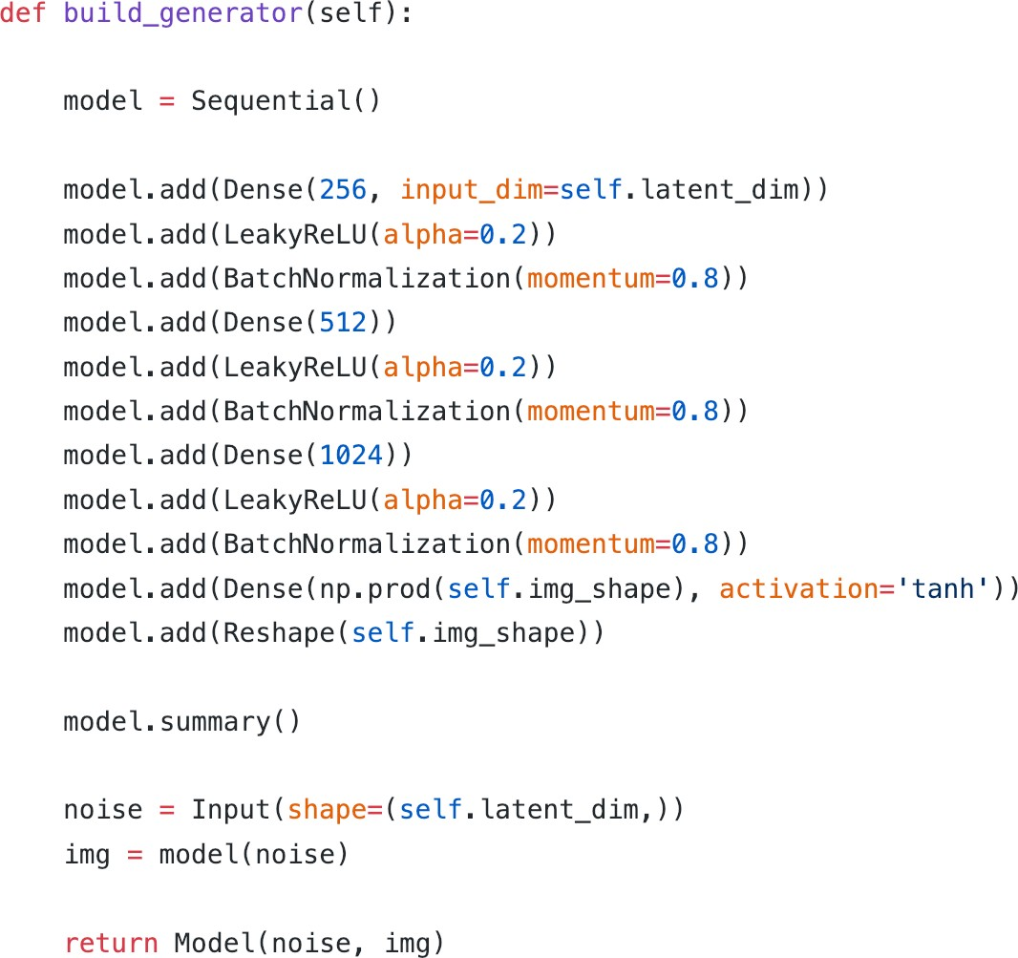
II. D. In terms of code
[Erik Linder-Norén (Github): eriklindernoren/Keras-GAN: link]

Slide 27
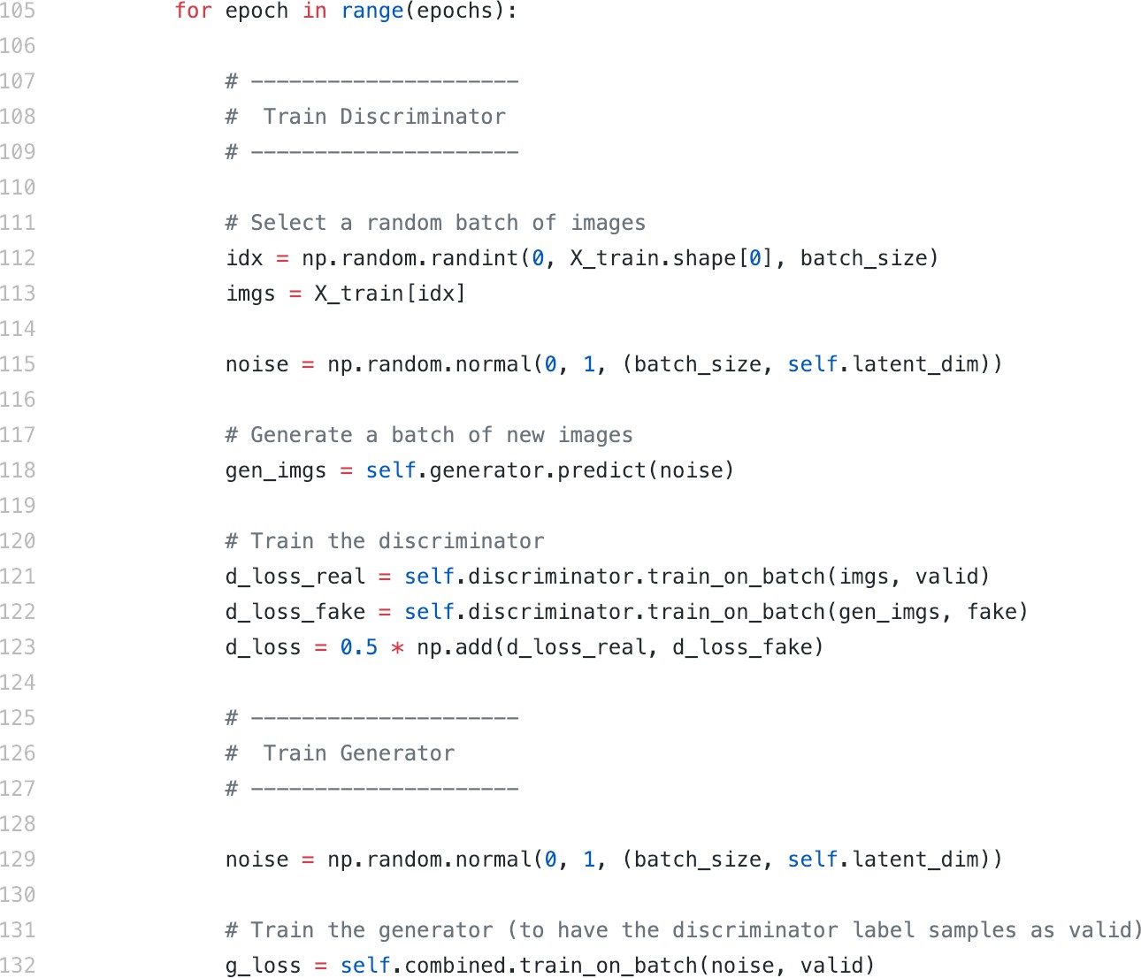
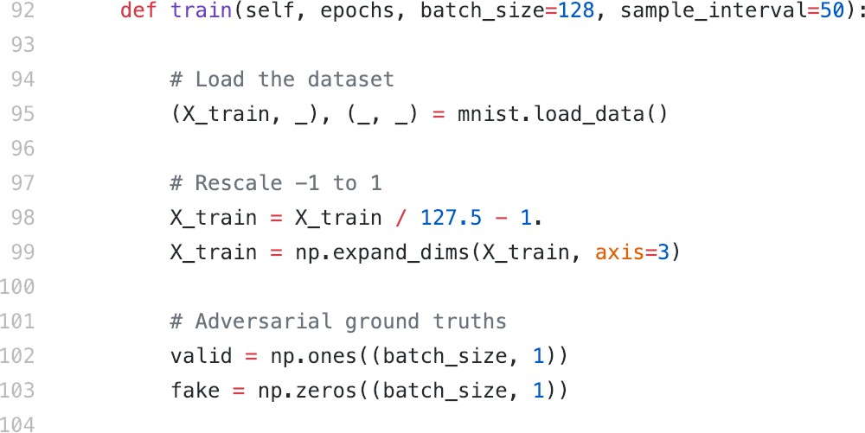
II. D. In terms of code
[Erik Linder-Norén (Github): eriklindernoren/Keras-GAN: link]

Slide 28
II. Generative Adversarial Networks (GANs)
Motivation
G/D Game
Training GANs
In terms of code
Nice results
[Ian J. Goodfellow, Jonathon Shlens & Christian Szegedy (2015): Explaining and harnessing adversarial examples]

Slide 29
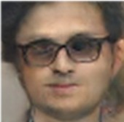
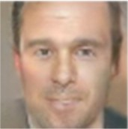
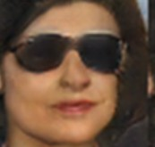
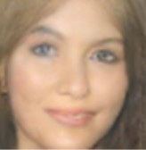
II.E - Nice results
Operation on codes
Code 1
(64,64,3)
generated image
⎛ 0.12⎞
Generator “G” (Neural Network)
⎜ ⎟
⎜ ⎟
⎜ ⎟
1
⎜⎝ 0.92⎟⎠
Code 2
(64,64,3)
generated image
Generator “G” (Neural Network)
Code 1
Code 2
Code 3
⎛ 0.47⎞
Generator “G” (Neural Network)
⎜ ⎟
⎜ ⎟
⎛ 0.12⎞
⎛ 0.47⎞
⎛ 0.42⎞
⎜ ⎟
⎜ ⎟ - ⎜ ⎟+⎜
⎜ ⎟
⎟
⎜ ⎟
2
⎜ ⎟
⎜⎝ 0.19⎟⎠
⎜ ⎟
⎜ ⎟
⎜ ⎟
⎜⎝ 0.92⎟⎠
⎜⎝ 0.19⎟⎠
⎜⎝ 0.07⎟⎠
Code 3
(64,64,3)
generated image
⎛ 0.42⎞
Generator “G” (Neural Network)
⎜ ⎟
⎜ ⎟
2
Man with glasses - man + woman = woman with glasses
⎜ ⎟
⎜⎝ 0.07⎟⎠
[Radford et al. (2015): UNSUPERVISED REPRESENTATION LEARNING WITH DEEP CONVOLUTIONAL GENERATIVE ADVERSARIAL NETWORKS]

Slide 30
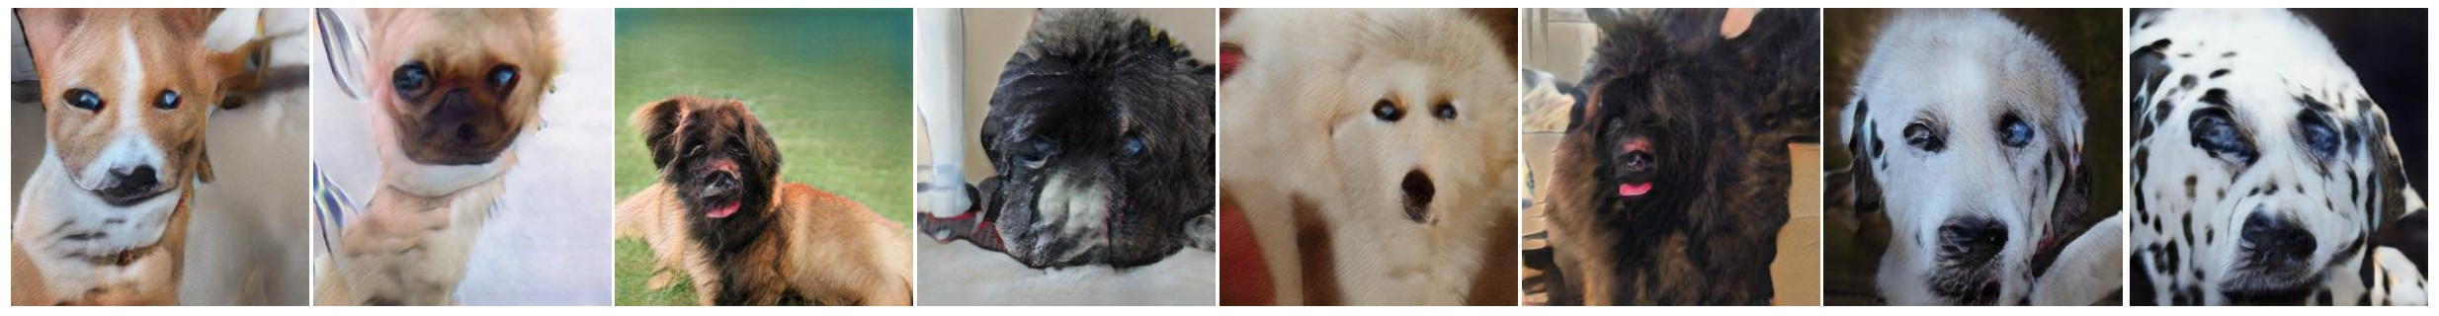
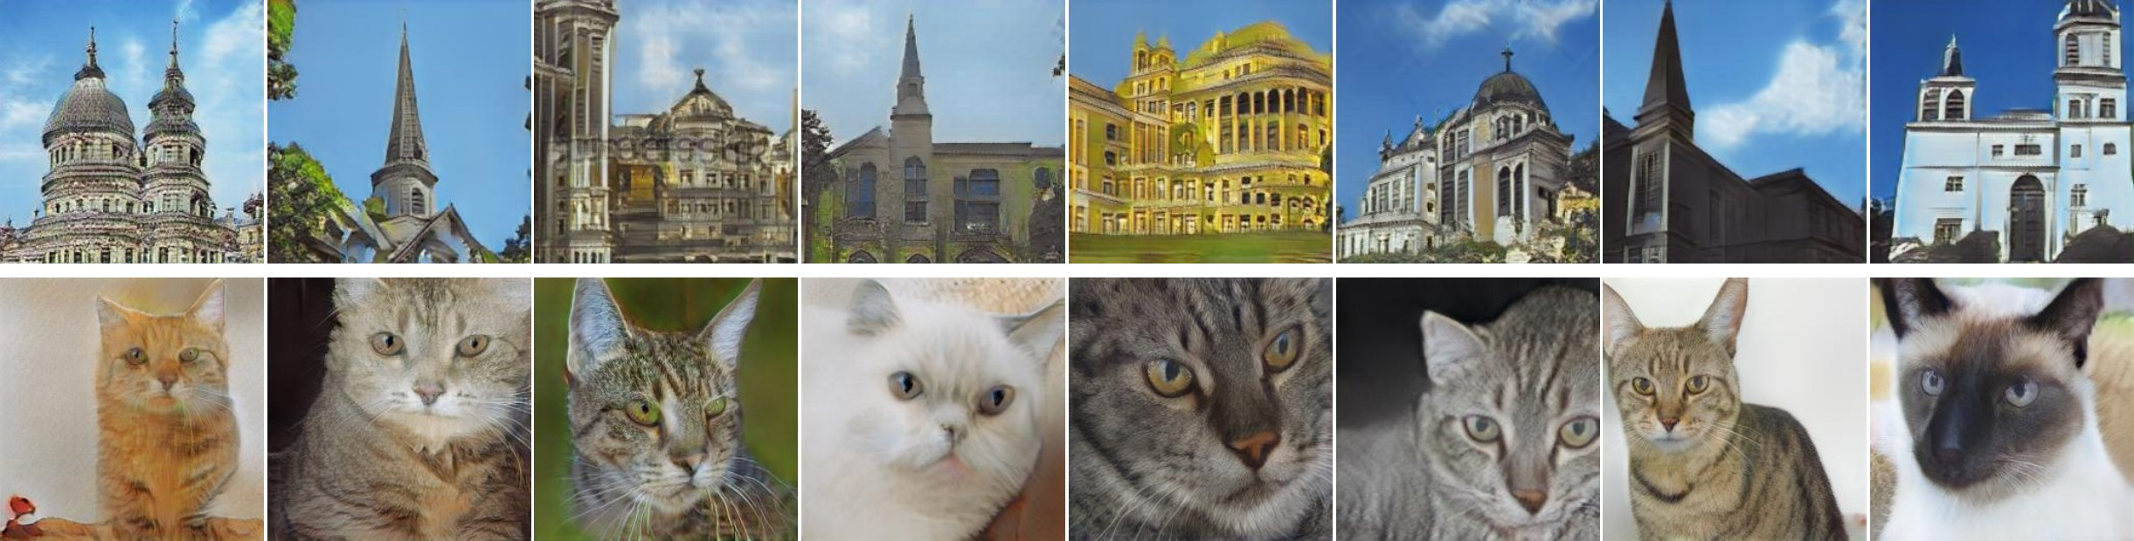
II.E - Nice results
Image Generation:
Samples from the “generated distribution”
[Zhang et al. (2017): StackGAN++]

Slide 31
II.E - Nice results
[Karras et al. (2018): A Style-Based Generator Architecture for Generative Adversarial Networks]
https://youtu.be/kSLJriaOumA

Slide 32
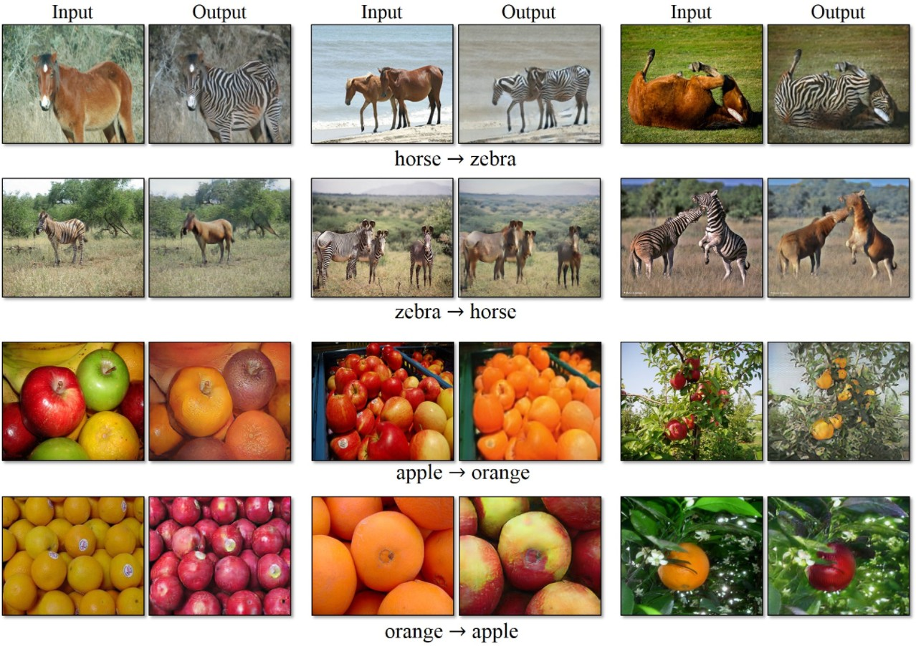
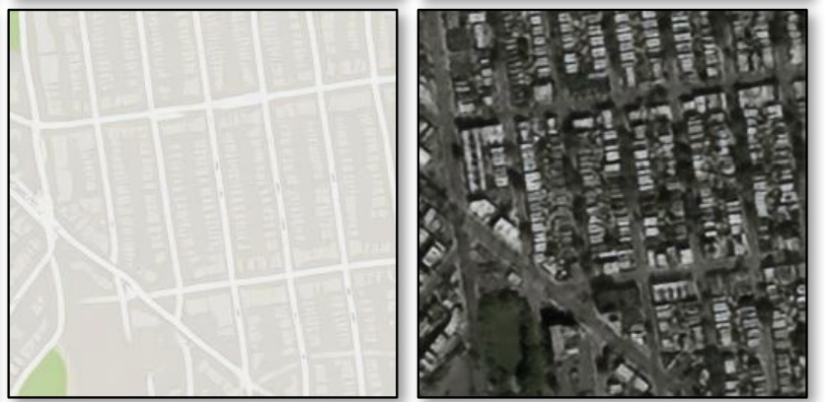
II.E - Nice results
[Zhu, Park et al. (2017): Unpaired Image-to-Image Translation using Cycle-Consistent Adversarial Networks]

Slide 33
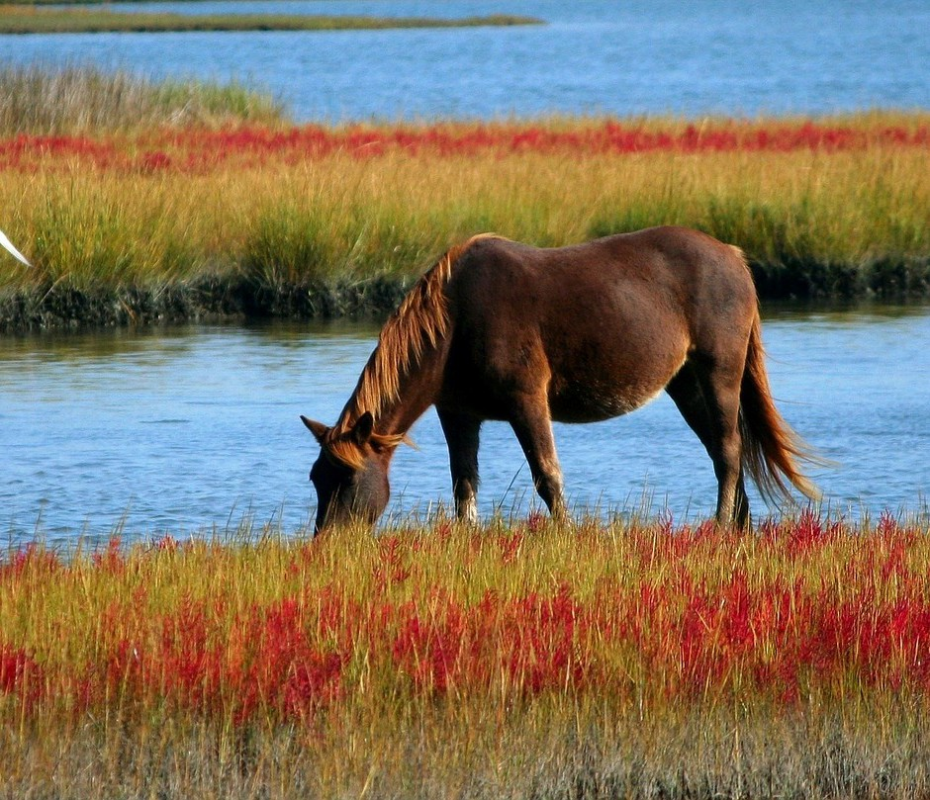
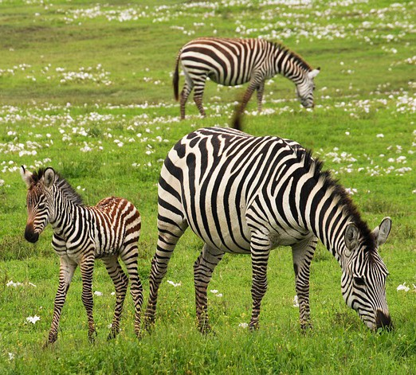
II.E - Nice results
Goal: Convert horses to zebras on images, and vice-versa.
Data?
Architecture?
Cost?
Unpaired images
Horse images
Zebra images
[Zhu, Park et al. (2017): Unpaired Image-to-Image Translation using Cycle-Consistent Adversarial Networks]

Slide 34




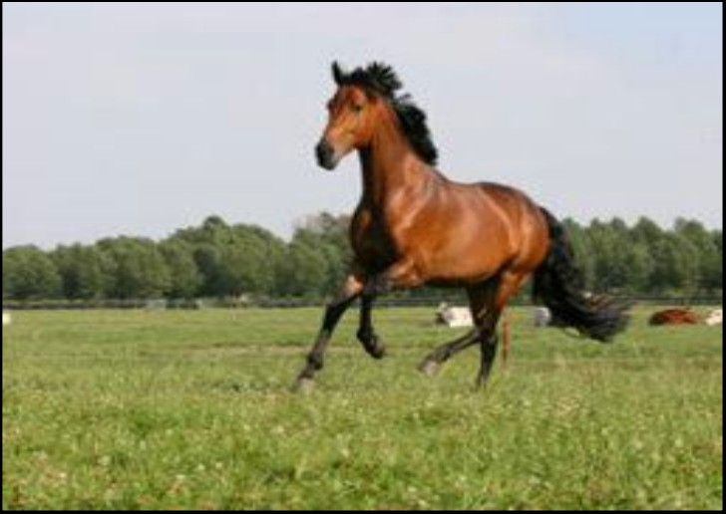
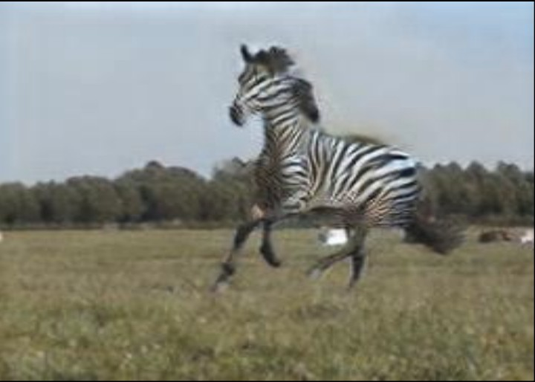
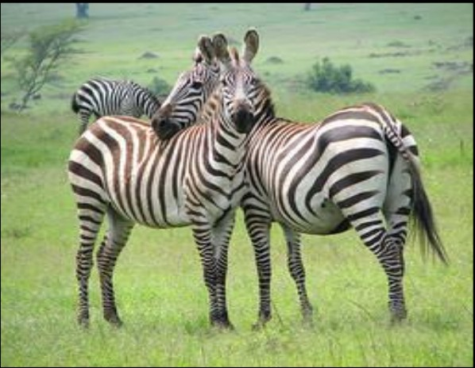
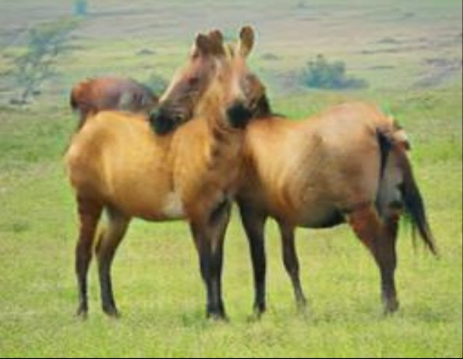
II.E - Nice results
Architecture?
⎧ y = 0 if x = G1( H )
⎪
⎨
y = 1 otherwise (x = z)
⎪⎩
H2Z
x = G2(Z )
H
G1(H)
Generator1 (H2Z)
Discriminator1
⎧ y = 0 if
⎪
⎨
⎪⎩ y = 1 otherwise (x = h)
G2(G1(H))
Generator2 (Z2H)
⎧ y = 0 if
x = G1( H )
Discriminator2
⎪
⎨
⎪⎩ y = 1 otherwise (x = z)
G1(G2(Z))
Generator1 (H2Z)
Discriminator1
⎧
⎪ y = 0 if
x = G2(Z )
⎨
⎪⎩ y = 1 otherwise (x = h)
G2(Z)
Z
Discriminator2
Generator2 (Z2H)
Z2H
[Zhu, Park et al. (2017): Unpaired Image-to-Image Translation using Cycle-Consistent Adversarial Networks]

Slide 35





II.E - Nice results
Loss to minimize?
⎧⎪ y = 0 if x = G1( H )
G1
⎨
⎪⎩ y = 1 otherwise
D1
1
^{m}real
1
^{m}gen
G2
_{J} ( D1) ₌ ₋
∑log( D1(z^{( i )} )) −
∑log(1− D1(G1( H ^{( i )} )))
^{m}real
i=1
^{m}gen
i=1
G1
1
^{m}gen
⎧⎪ y = 0 if x = G2(Z )
_{J} (G1) ₌ ₋
∑log( D1(G1( H ^{( i )} )))
⎨
⎪⎩ y = 1 otherwise
D2
G2
^{m}gen
i=1
1
^{m}real
1
^{m}gen
_{J} ( D 2) ₌ ₋
∑log( D2(h^{( i )} )) −
∑log(1− D2(G2(Z ^{( i )} )))
^{m}real
i=1
^{m}gen
i=1
1
^{m}gen
_{J = J} ( D1) _{+ J} (G1) _{+ J} ( D 2) _{+ J} (G 2) _{+ λ J} cycle
_{J} (G 2) ₌ ₋
∑log( D2(G2(Z ^{( i )} )))
^{m}gen
i=1
_{J} cycle ₌ ₋
1
^{m}gen
1
^{m}gen
∑
|| G2(G1( H
( i )
( i )
∑
( i )
( i )
) − H || −
|| G1(G2(Z
) − Z ||
m
1
m
1
gen
i=1
gen
i=1

Slide 36

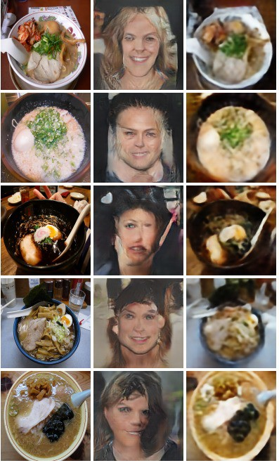
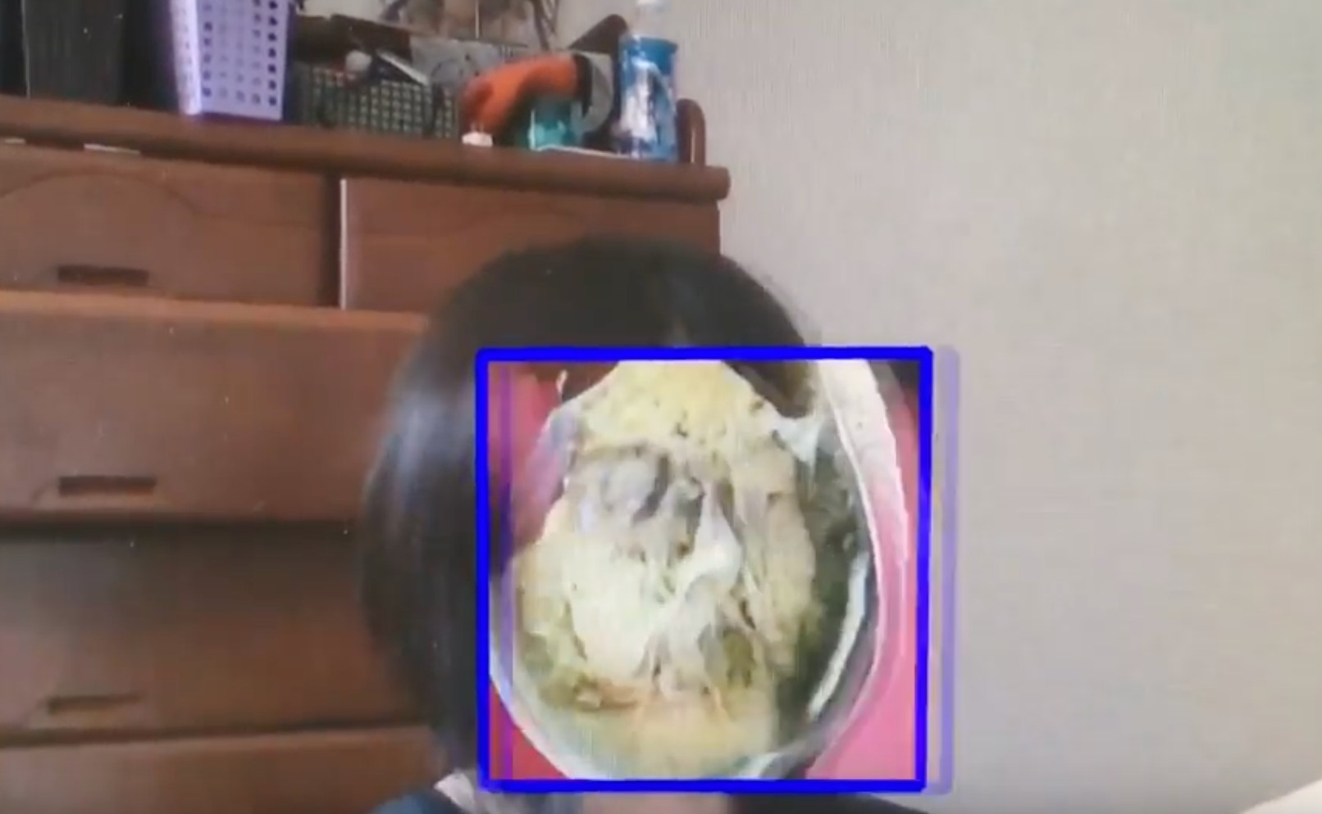
II.E - Nice results
CycleGANs:
Face2ramen
+ Face detection
[Shu Naritomi et al.: Face2Ramen]
[Takuya Tako: Face2Ramen using CycleGAN]
[Zhu, Park et al. (2017): Unpaired Image-to-Image Translation using Cycle-Consistent Adversarial Networks]

Slide 37
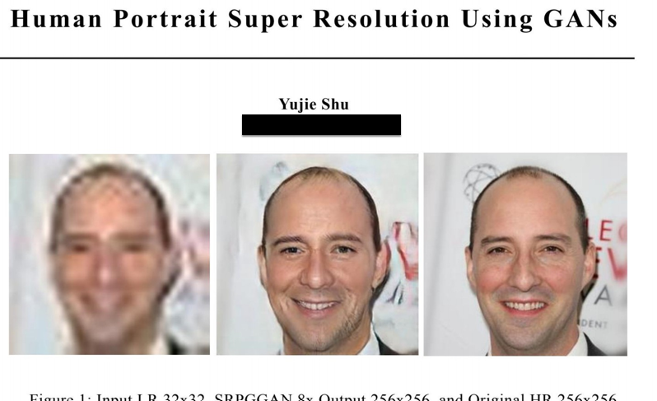
II.E - Nice results
Super-resolution
[Ledig et al. (2016): Photo-Realistic Single Image Super-Resolution Using a Generative Adversarial Network]

Slide 38
Summary
Component | Description
Generator | Simple 2-layer MLP: noise → 28×28 image
Discriminator | 2-layer binary classifier: real/fake
Dataset | Fashion-MNIST (28×28 grayscale)
Training time | ≈ 2–3 minutes on CPU
Result | After ~1500–2000 epochs, you'll see the generator producing rough clothing-like textures

Slide 39
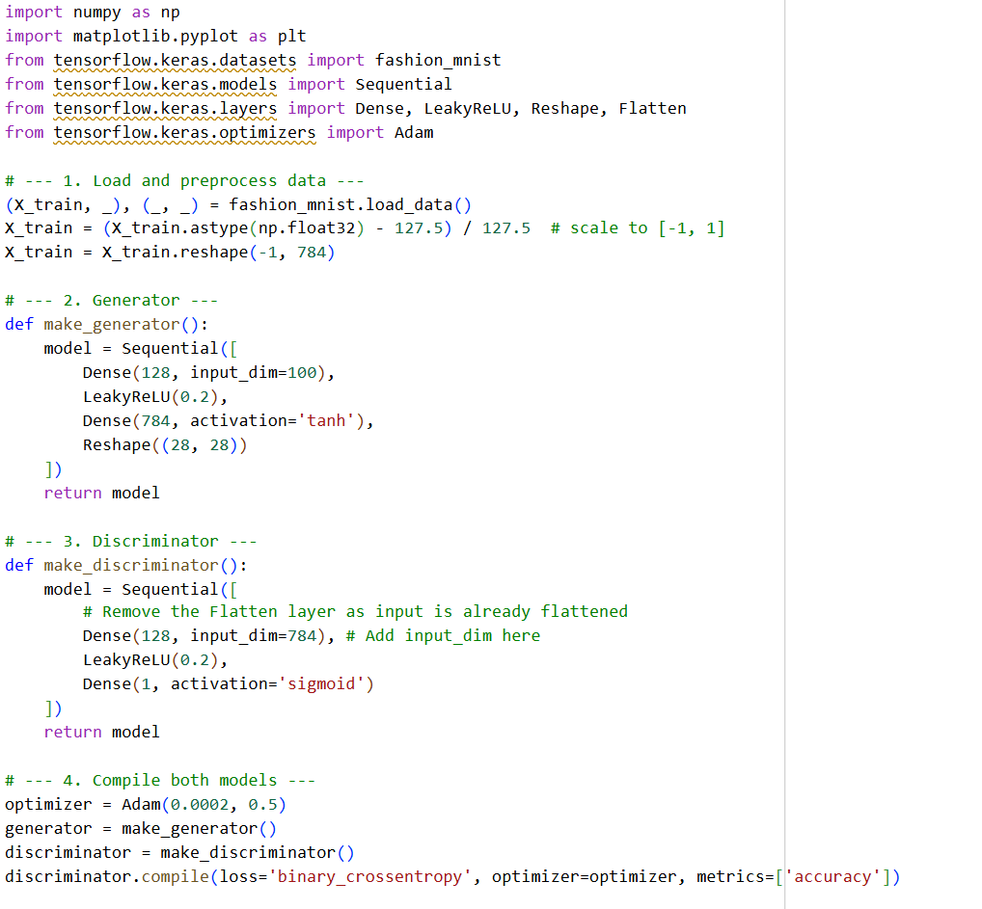

Slide 40
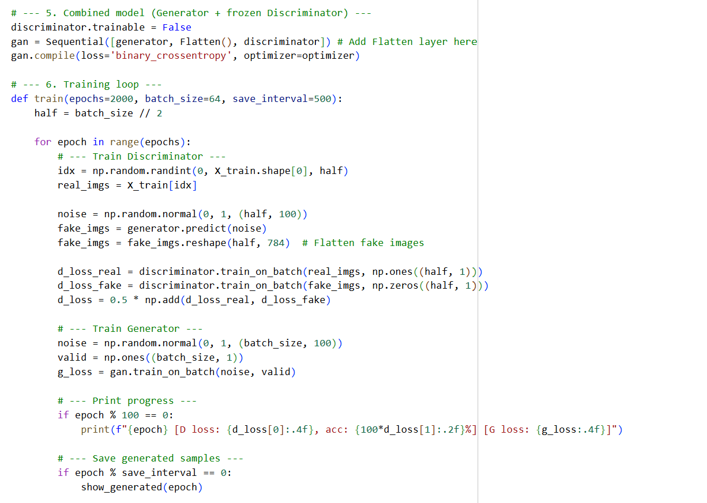

Slide 41
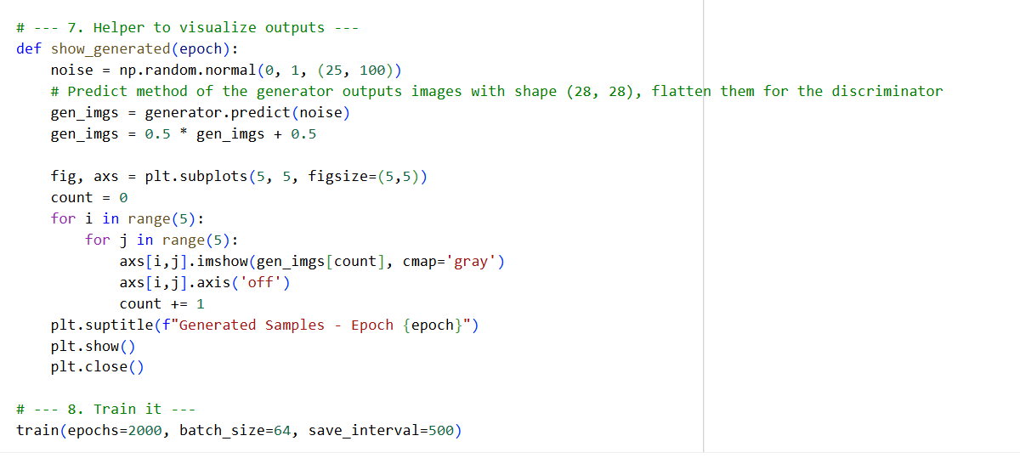

Slide 42
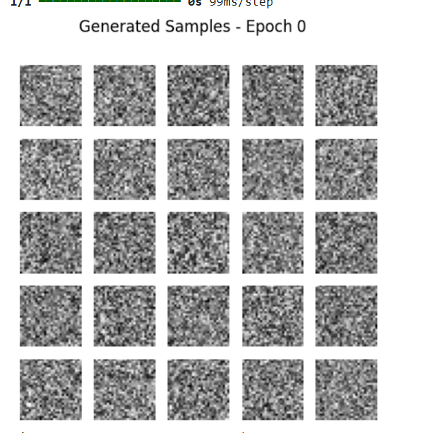


Slide 43



Slide 44
Key Notes
Component | Description
Dataset | CIFAR-10 (32×32 RGB images of animals, vehicles, etc.)
Generator | Fully connected network → reshaped to (32, 32, 3)
Discriminator | 2 hidden layers, binary classifier
Training time | ~5–8 min on CPU / <2 min on GPU
Result | Generates coarse colored blobs that gradually resemble CIFAR objects after ~2000 epochs

Slide 45


Slide 46


Slide 47



Slide 48
Generator: Learns to map random noise → fake clothing images.
Discriminator: Learns to distinguish real Fashion-MNIST samples from generated ones.
Training: Alternates between training the discriminator on real and fake images, and training the generator to fool the discriminator.
Visualization: Every 1000 epochs, you’ll see samples of generated “clothing” evolve from random noise to realistic shapes.

Slide 49

Conditional GAN (cGAN) using Fashion-MNIST, where the generator learns to produce specific clothing items (like shirts, shoes, or bags) based on a class label.
This example conditions both the generator and discriminator on a class label (0–9) from Fashion-MNIST.

Slide 50


Slide 51


Slide 52


Slide 53


II.E - Evaluating GANs
How to evaluate GANs?
Human annotators
Inception Score (IS)
IS(G) = exp(Ε
)
web-application
⎣⎡ KL( p( y | x) || p( y))
⎤
⎦
Indicate if image is fake or real
x∼ p_{g}
Image Image Image
1 2 3
Measure of image quality
Measure of image diversity
Image Image Image
4 5 6
⎛ ₁
m
n
y
⎛
1
m
⎞ ⎞
b
b
IS(G) = exp⎜
∑∑
ˆ
( i )
j
ˆ
( i )
j
∑
ˆ
( k )
j
y
⎜
log y
− log(
y
)
⎟
⎟
m
m
⎝
i=1 j=1
⎝ ⎠
⎠
b
_{b} k =1
Also: Fréchet Inception Distance (FID)
[Lucic, Kurach et al. (2018): Are GANs Created Equal? A Large-Scale Study] [Salimans et al. (2016): Improved Techniques for Training GANs]

Slide 54



Slide 55



Slide 56


Slide 57
DCGAN (Deep Convolutional GAN) using CIFAR-10 — this is the standard architecture that produces realistic-looking small color images (dogs, airplanes, cars, etc.) using convolutional layers.
Summary
Component | Description
Generator | Upsamples from 4×4 to 32×32 using Conv2DTranspose layers
Discriminator | CNN that classifies real vs fake
Dataset | CIFAR-10 (32×32 RGB)
Training time | ~5–10 min on GPU, ~20–30 min on CPU
Output | Colorful 32×32 images resembling CIFAR-10 objects after ~4000–5000 epochs

Slide 58


Slide 59


Slide 60


Slide 61


After 44 minutes

Slide 62



After 37 minutes
After 20 minutes

Slide 63


After 54 minutes
After 98 minutes

Slide 64
DCGANs are the first GAN architecture that made image generation “realistic enough” to be useful — they bridge the gap between toy GANs and modern image synthesis models.
Benefit | Explanation
Higher-quality images | Learns local structure with convolutions
Training stability | Less gradient instability than MLP GANs
Fewer parameters | Shared convolutional weights
Transferable features | Discriminator learns reusable representations
Scalable to large datasets | Works with higher-resolution inputs
Smooth latent space | Enables realistic interpolation between images

Slide 65
Benefits of DCGANs
Better Image Quality
Convolutional layers learn spatial hierarchies — edges, textures, shapes — instead of treating pixels as independent.
This helps the generator create realistic, coherent images rather than blurry blobs.
The discriminator also becomes far better at distinguishing real vs. fake images.
Example: A fully connected GAN trained on CIFAR-10 may produce colorful noise, while a DCGAN learns patterns resembling airplanes, dogs, or cars.

Slide 66
Parameter Efficiency
CNNs use shared weights and local receptive fields, so they need fewer parameters to capture structure in 2D images.
This reduces memory footprint and makes training more stable and efficient.
Stability in Training
DCGANs typically converge faster and more reliably than dense GANs.
The architectural guidelines (e.g., using LeakyReLU, BatchNorm, strided convolutions) help prevent mode collapse and gradient explosion/vanishing.

Slide 67
Learned Feature Representations
The discriminator’s convolutional layers learn useful unsupervised visual features.
These learned features can be reused (fine-tuned) for image classification or transfer learning — even though no labels were used.
Example: Features from a DCGAN’s discriminator can help train a classifier with fewer labeled samples.

Slide 68
Scalability
DCGANs scale naturally to larger and more complex datasets (e.g., CelebA, LSUN, ImageNet subsets).
They are the foundation for most advanced GANs:
Conditional GANs (cGANs)
StyleGAN
CycleGAN
Pix2Pix
Smooth Latent Space
Because of convolutional upsampling, interpolating between two random noise vectors produces smooth transitions in the generated images (e.g., a shoe slowly morphing into a shirt).
This shows the generator learned a continuous and meaningful data manifold.

